Slide 1
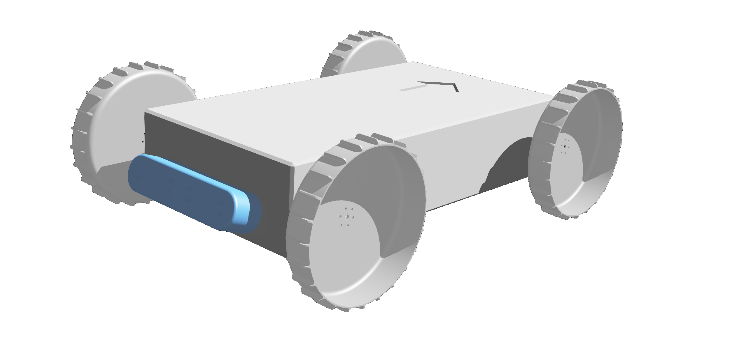














Z
R₁
Obstacle
Threshold
Obstacle
Zone
Punishment
Zone
Y
X

Slide 2
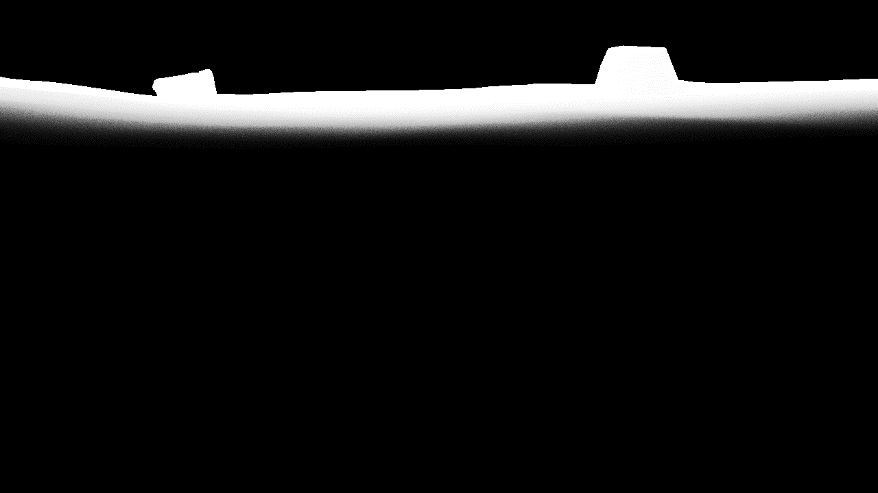

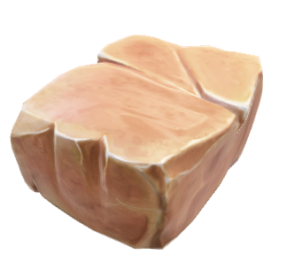
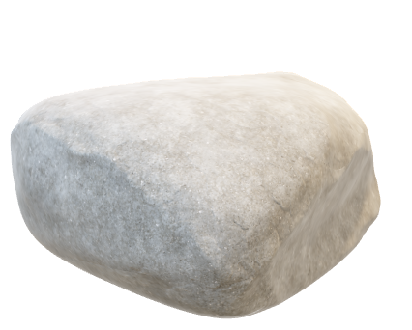
Irrelevant Far Region
Region of Interest
Irrelevant Region
Irrelevant Region
Irrelevant Region
Irrelevant Near Region
Region of Interest
Irrelevant Far Region
Irrelevant Region
Region of Interest
Irrelevant Region
Irrelevant Region
Irrelevant Near Region

Slide 3
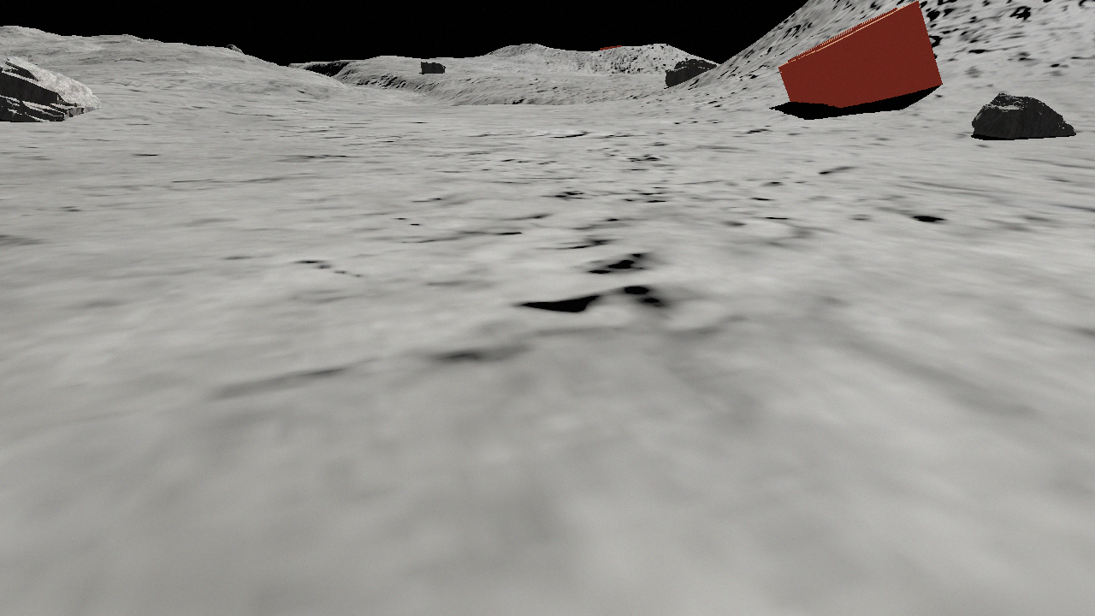
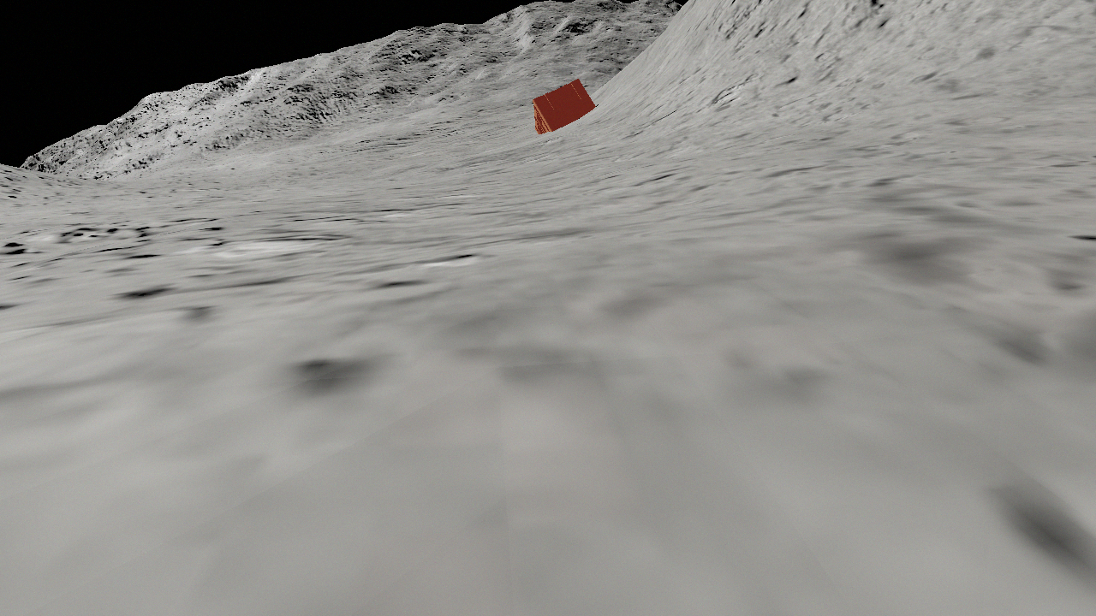
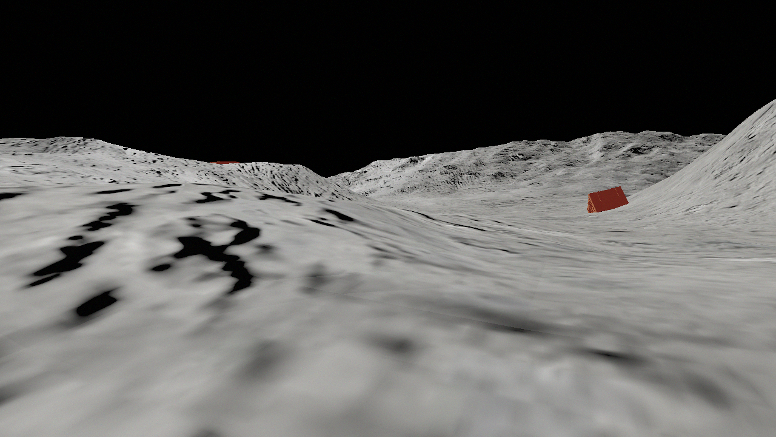
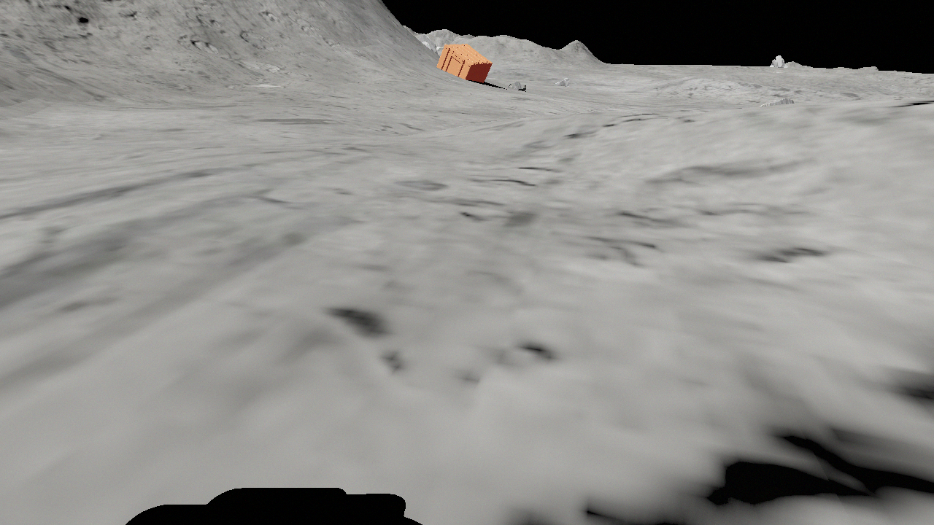

Timeline
Coordinate Transformation
Agent
Moving
…
……
……
…
DBSCAN
List of Target
World Coordinates
Agent
Resting
1.
DETIL
Filter
2.
…
……
……
…
…
N-1.
N.

Slide 4
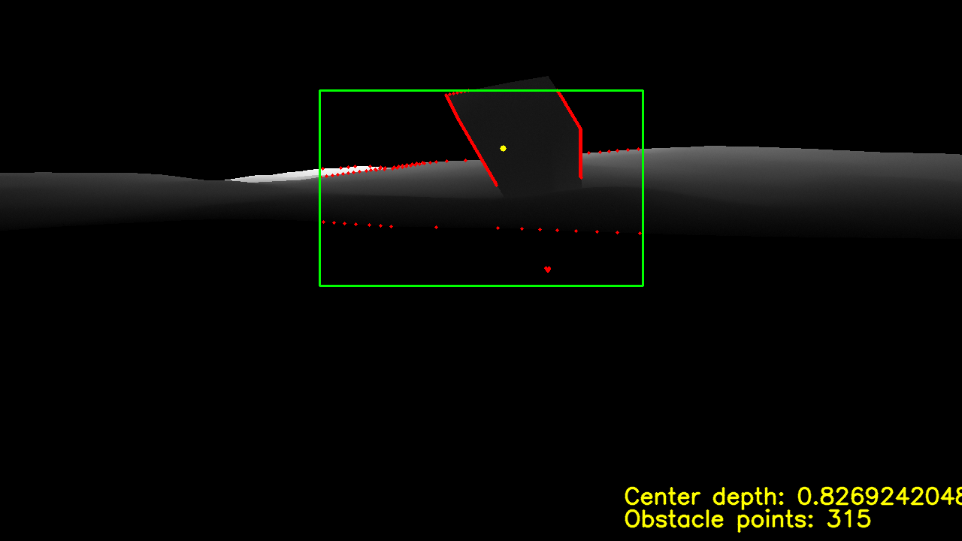
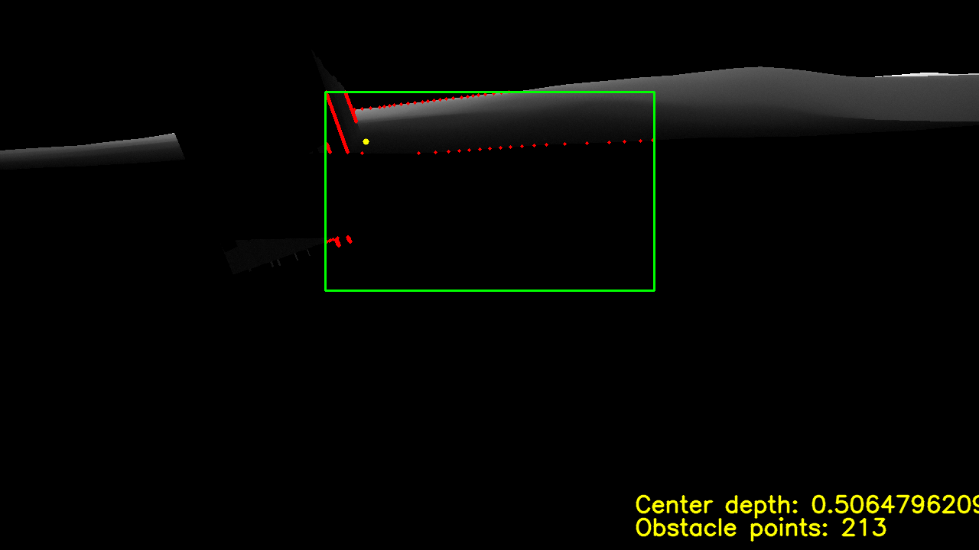

Slide 5
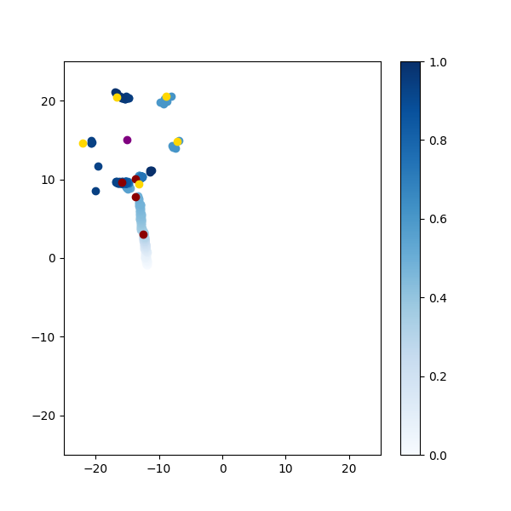


(a) DBSCAN (b) After splitting the original points into five segments, use DBSCAN for clustering (c) Clustering based on the spatiotemporal dimensions of DBSCAN

